Slide 1
Advanced Computer Programming Course Project CSE231S

Slide 2
Pharmacy Management System Team 11
Name | ID
Mohamed Walid | 2200243
Amr Asharf | 2201048

Slide 3
UML

Slide 4
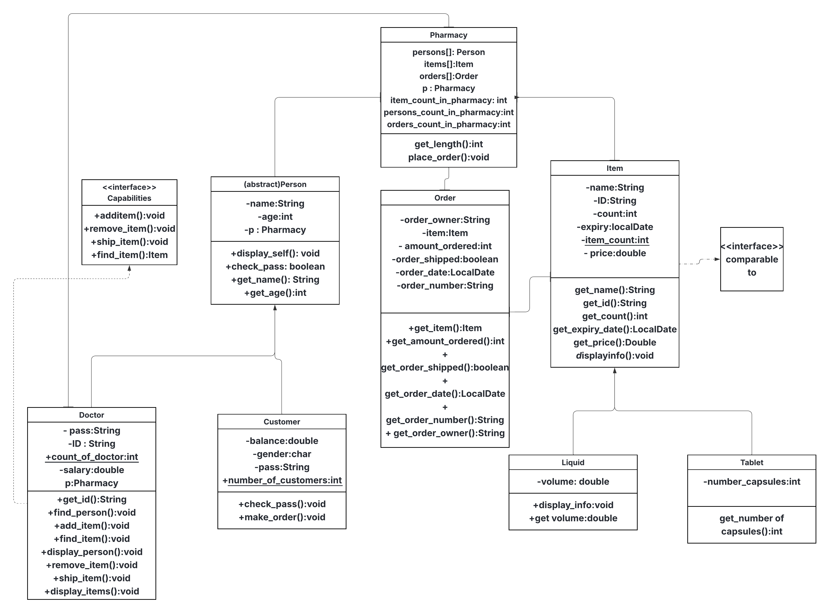
UML

Slide 5
Encapsulation

Slide 6
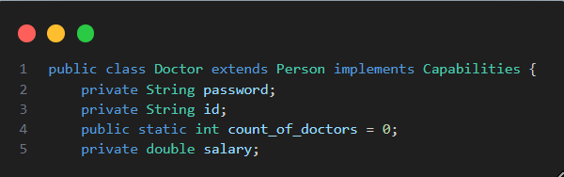
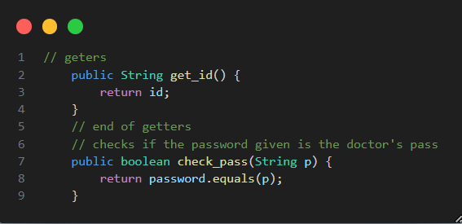
Encapsulation
How Encapsulation is applied
Every Data field is being private and only being accessed through
Getters and Setters

Slide 7
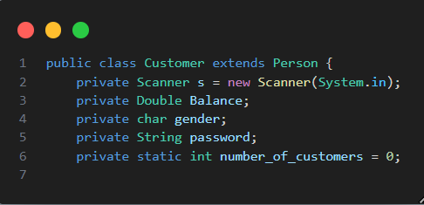
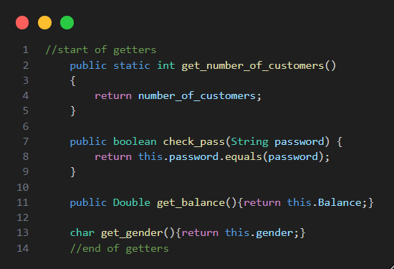
Encapsulation :continue
This is done to prevent the user to Modify the class's data field and only be able to accessed the data field through getters an setters

Slide 8
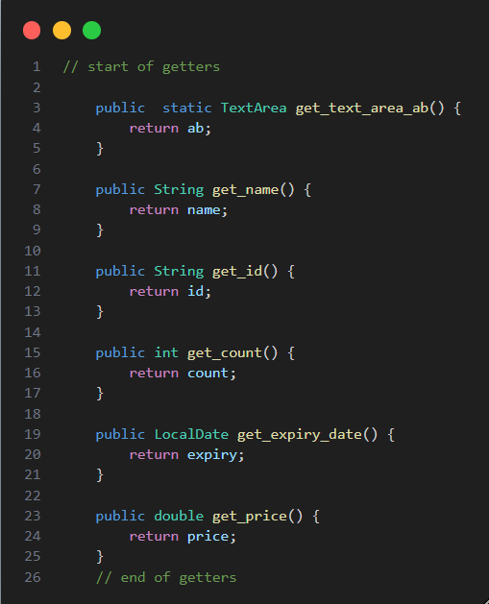
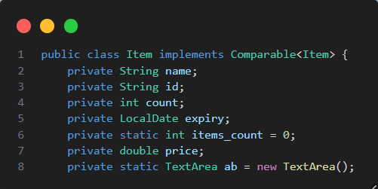
Encapsulation :continue
Examples:

Slide 9
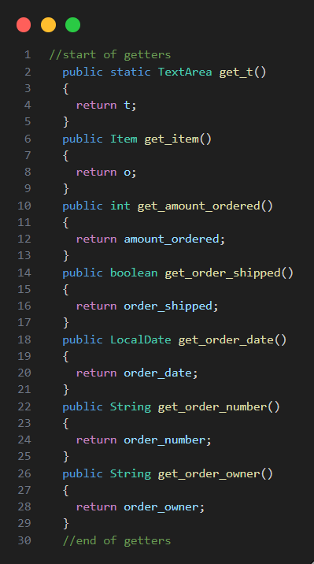
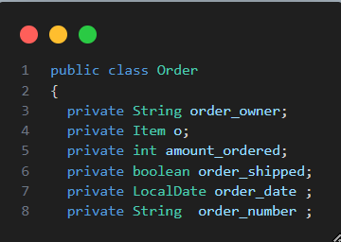
Encapsulation :continue
Examples:

Slide 10
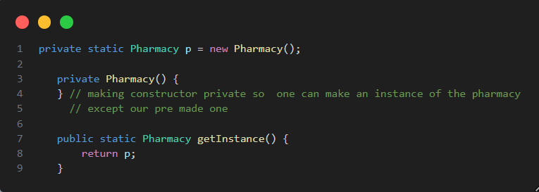
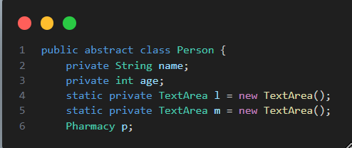
Encapsulation :continue
Here we used the singleton design pattern
One class one object
No need to be makaing the p refrence field private since it's only 1 object shared across all classes

Slide 11
Polymorphism

Slide 12
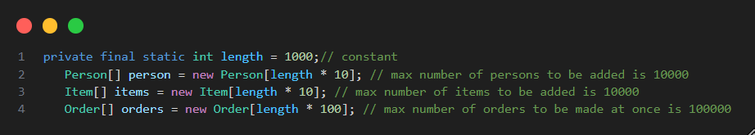
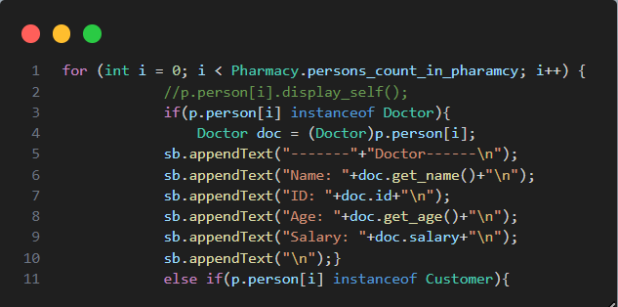
Polymorphism
Polymorphism was applied in the person class
person array held both Doctor and Customer objects so, we had to use instanceof operator to be able to know if this person a doctor or an customer

Slide 13
Abstract Class

Slide 14
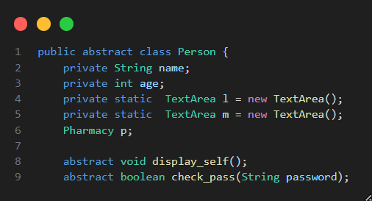
Abstract class
In this Project our abstract class is person
It has " displayinfo " and " check_pass " as an abstract method
Since Doctor and Customer would have different info
Item class could have been abstract if there is only 2 types of items in the phramacies (Liquid or Tablet)

Slide 15
Interface

Slide 16
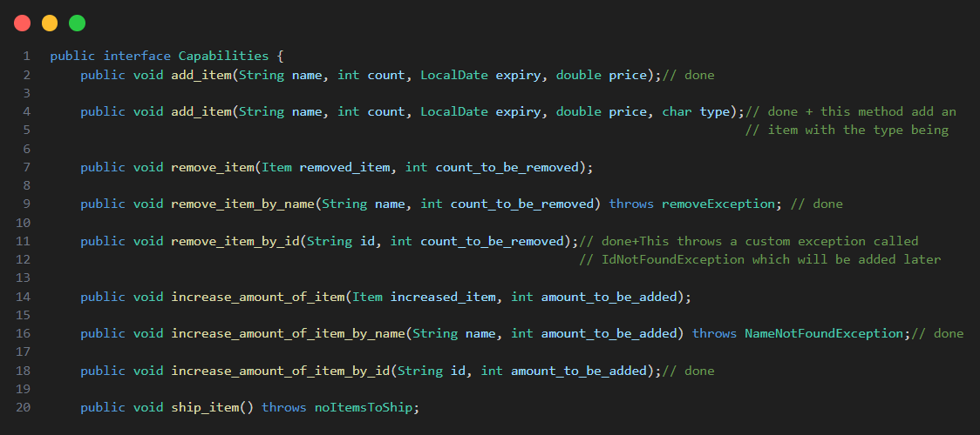
Interface
We made Capabilities interface for future adding of Employee class for Common action between employees and doctors

Slide 17
Sorting

Slide 18
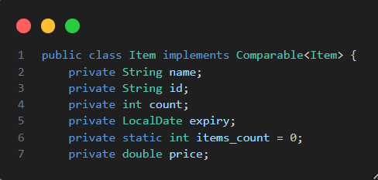
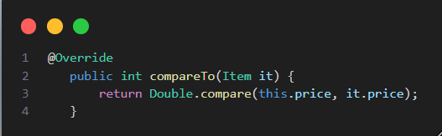
Sorting items
Generic Sort Had been implemented in the Item class
First, We have to implement comparable interface
Second , Override the " compareTo " method from the Object class
Here the comparison is according to the price of each element

Slide 19
Exception handling

Slide 20
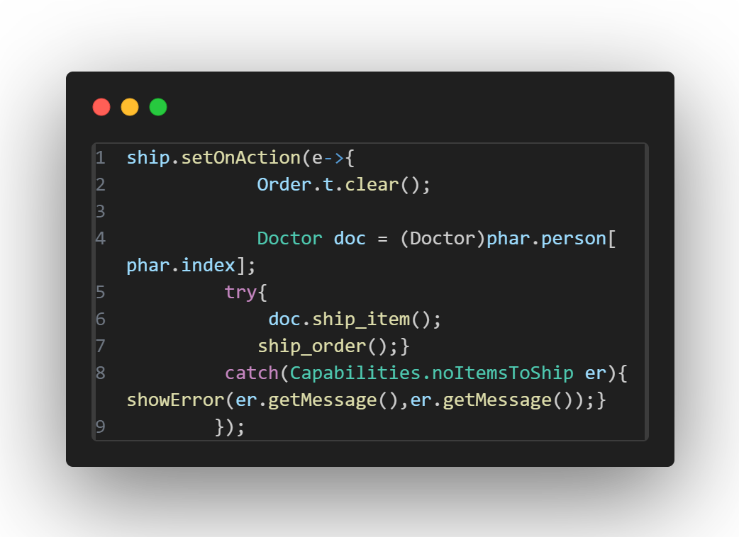
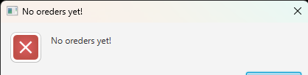
Exception handling
When a method throws an exception an error message appears to the user
Some exception are custom made to handle wrong inputs or actions requested that are not supposed to happen at that time

Slide 21
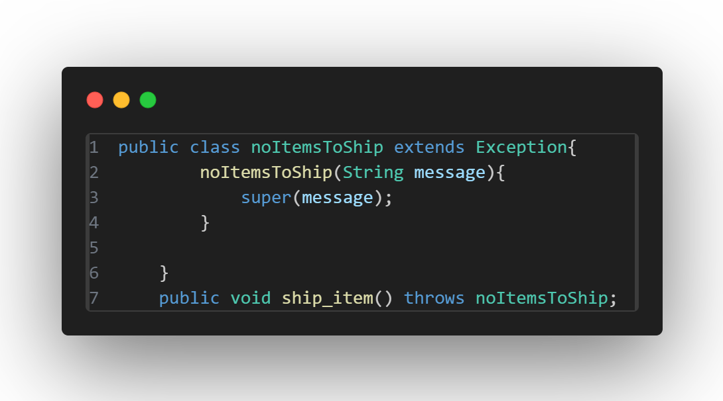
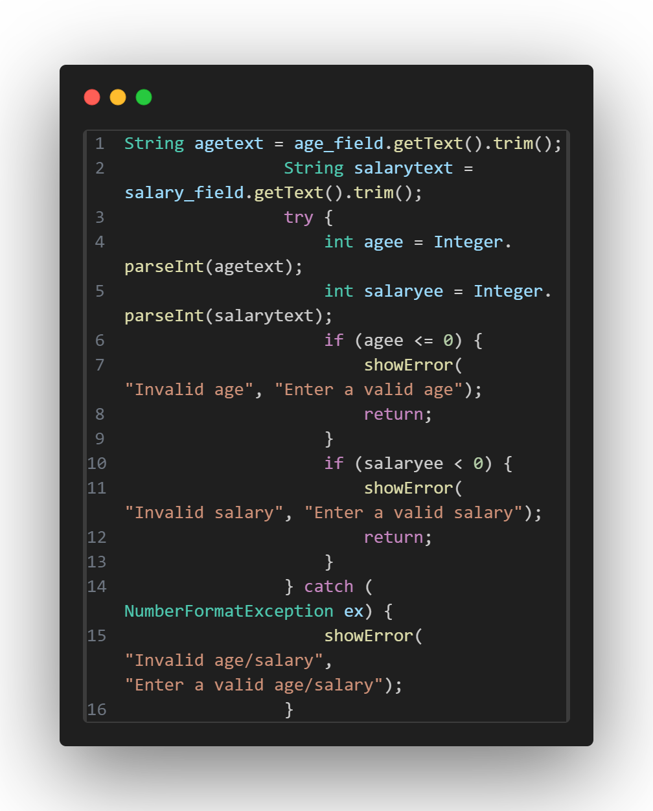
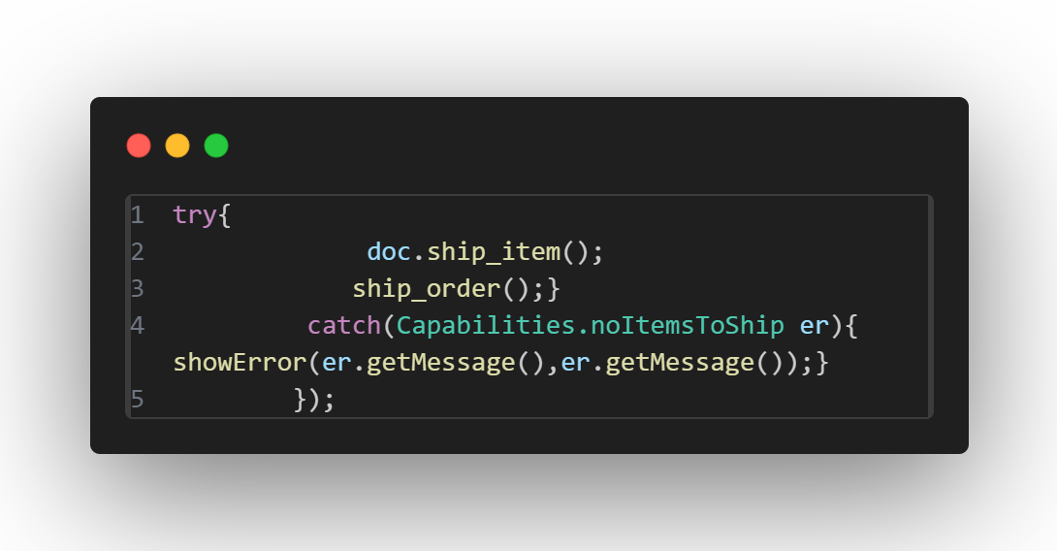
Exception handling

Slide 22
GUI

Slide 23
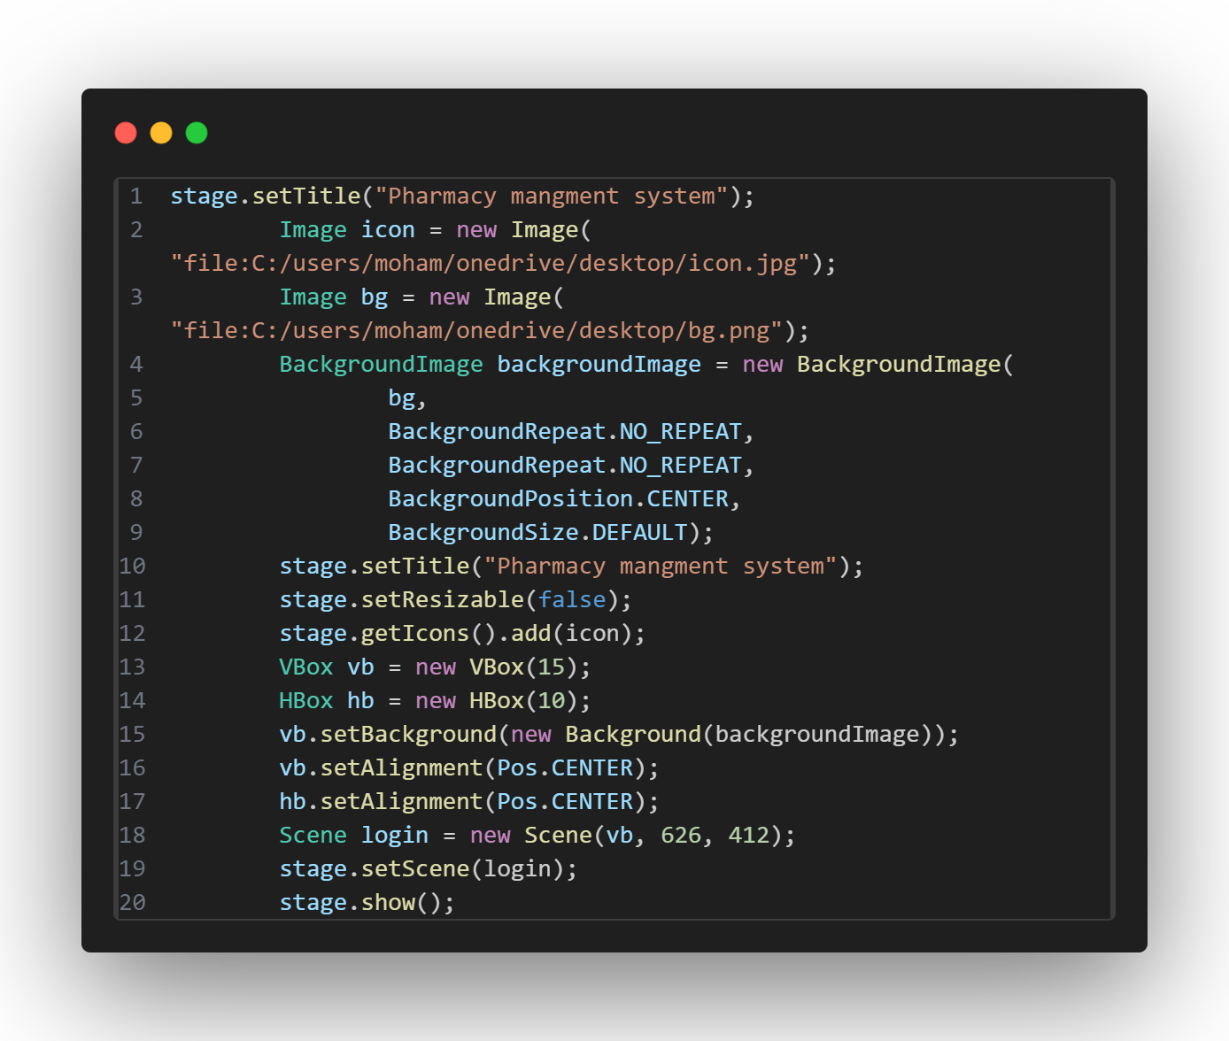
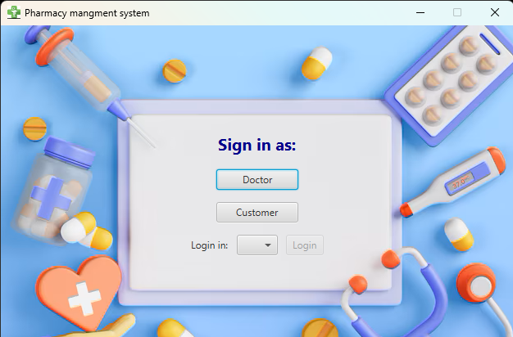
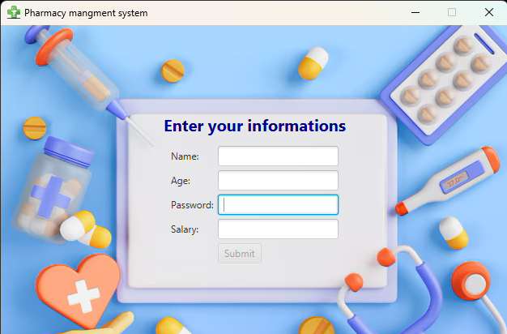
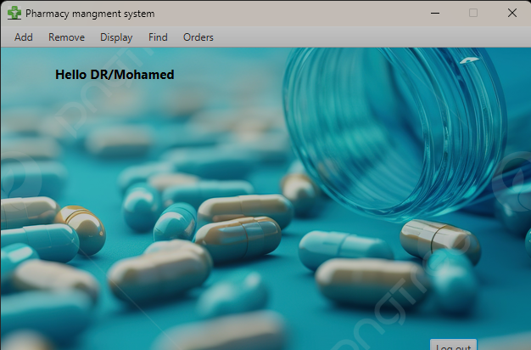
GUI

Slide 24
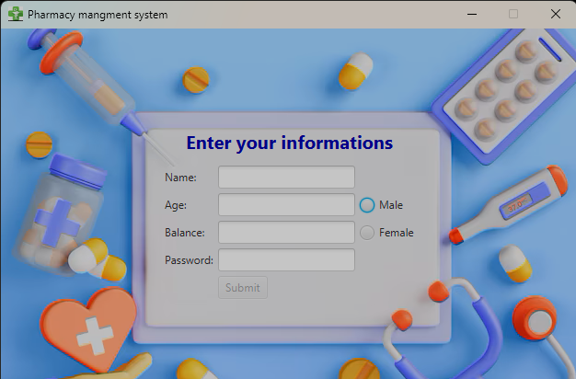
Inputs/outputs
Inputs are taken from the user via text fields or radio buttons
String input are taken using textField.getText() method while integer and doubles are casted using Integer.parseint() or Double.parsedouble();

Slide 25
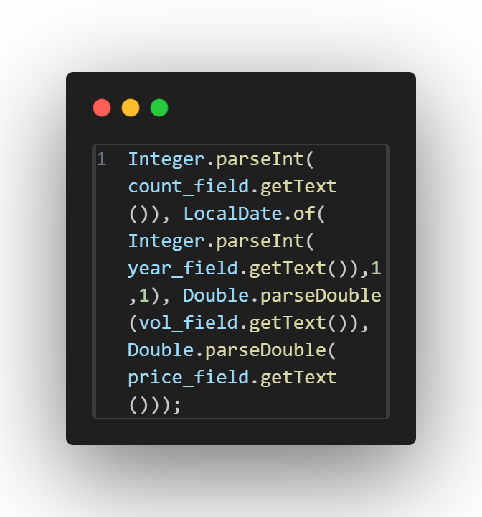
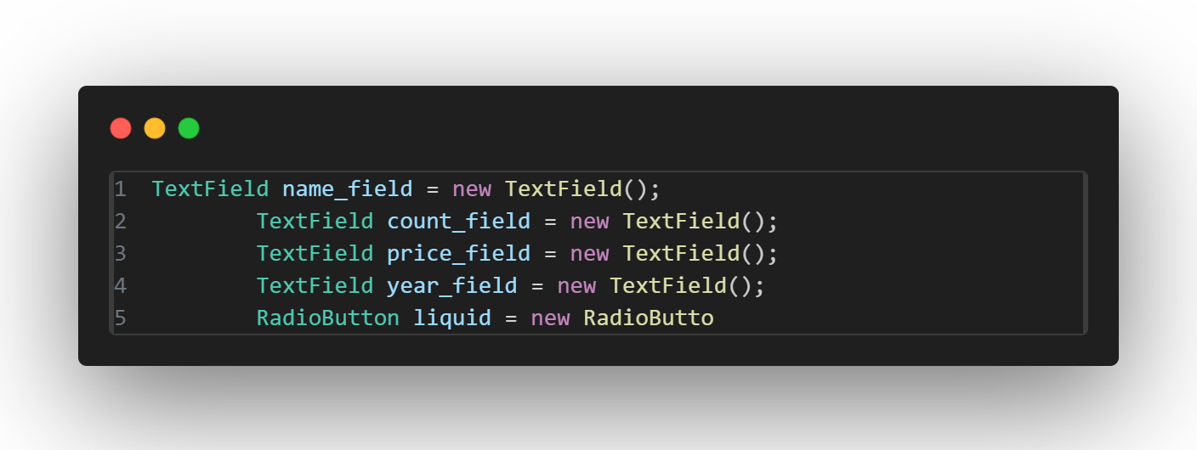
Inputs/outputs
Inputs are taken from the user via text fields or radio buttons
String input are taken using textField.getText() method while integer and doubles are casted using Integer.parseint() or Double.parsedouble();

Slide 26
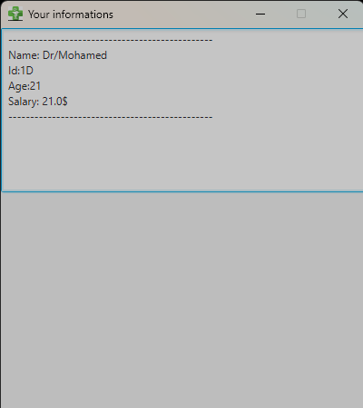
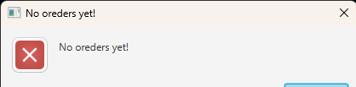
inputs/outputs
Outputs are either labels or new stages
Some outputs are error/alert messages when exceptions occur

Slide 27
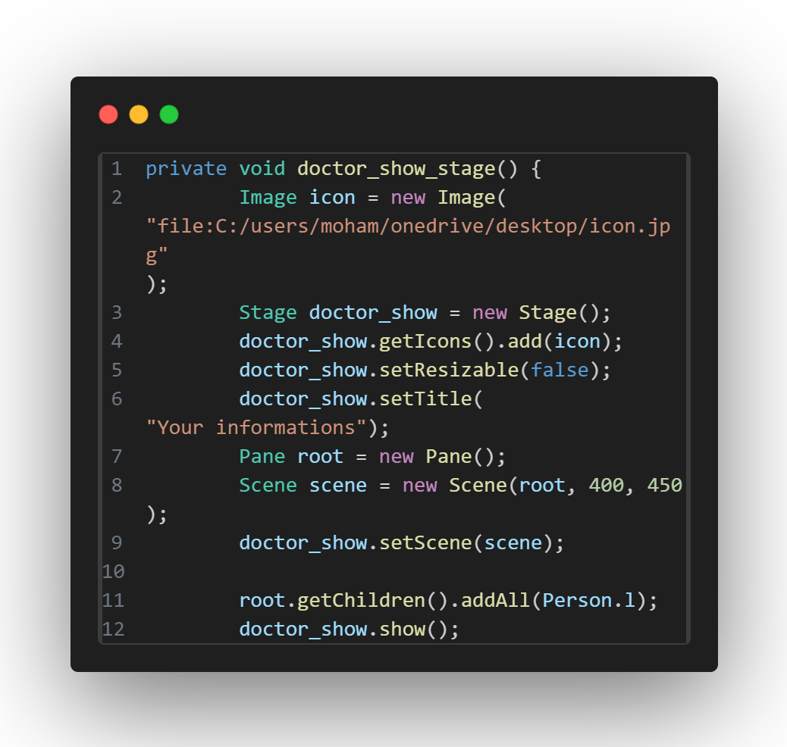
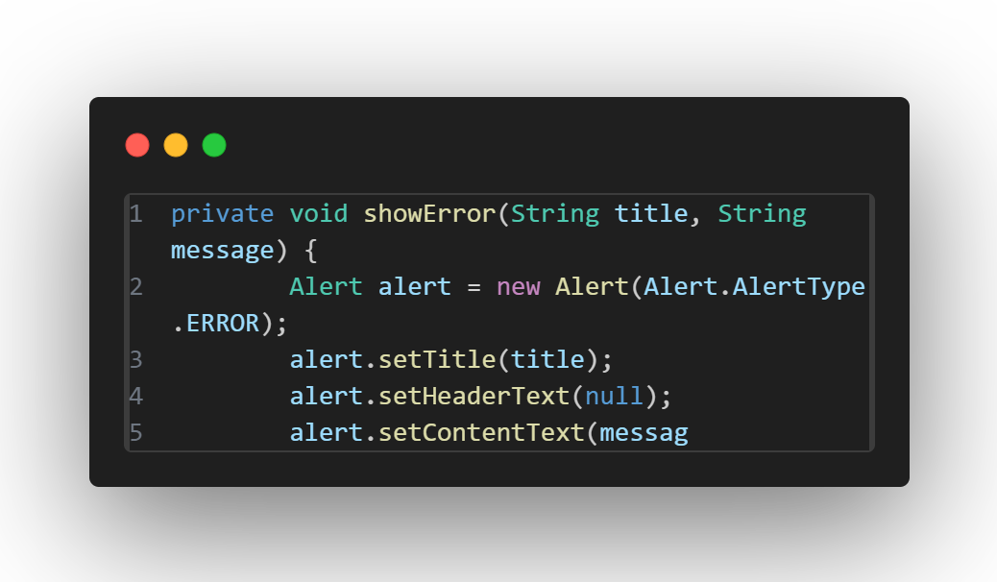
Inputs/outputs
Inputs are taken from the user via text fields or radio buttons
String input are taken using textField.getText() method while integer and doubles are casted using Integer.parseint() or Double.parsedouble();

Slide 28

Controllers
Buttons ,combo boxes and menu bars are used as controllers

Slide 29
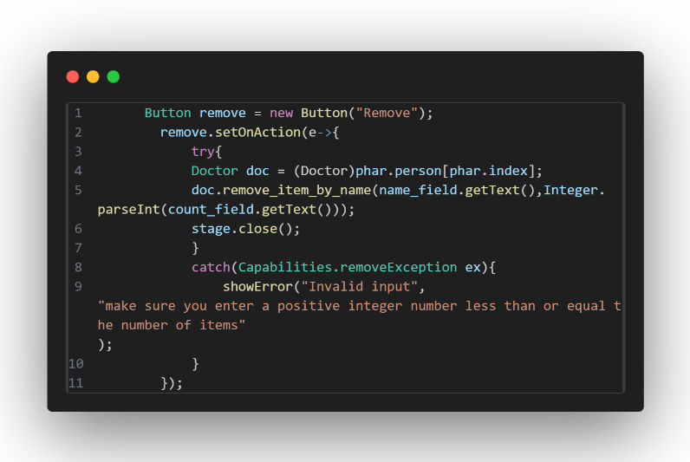
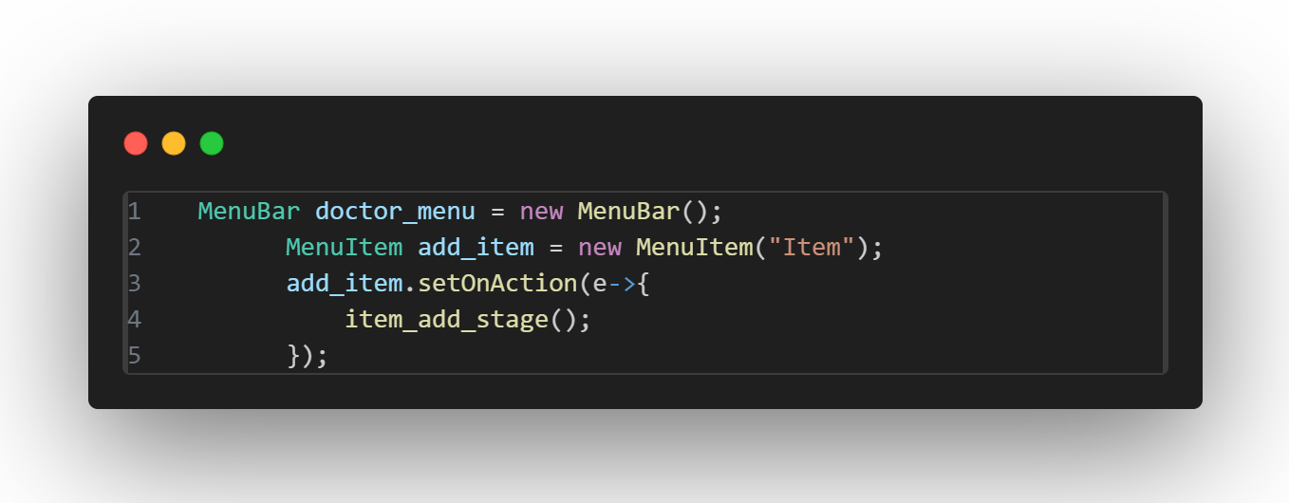
Controllers

Slide 30
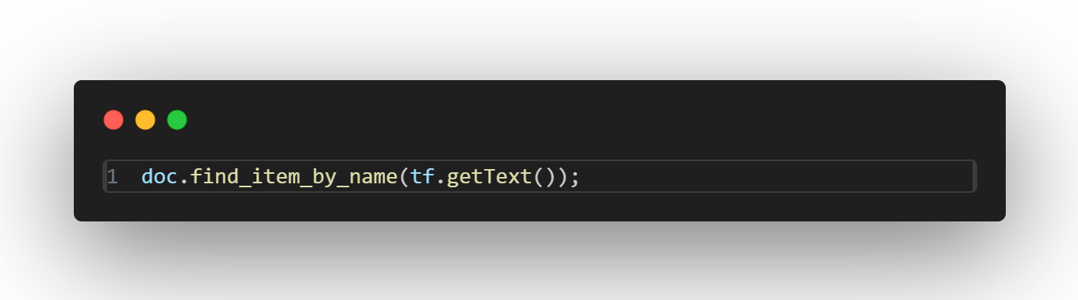
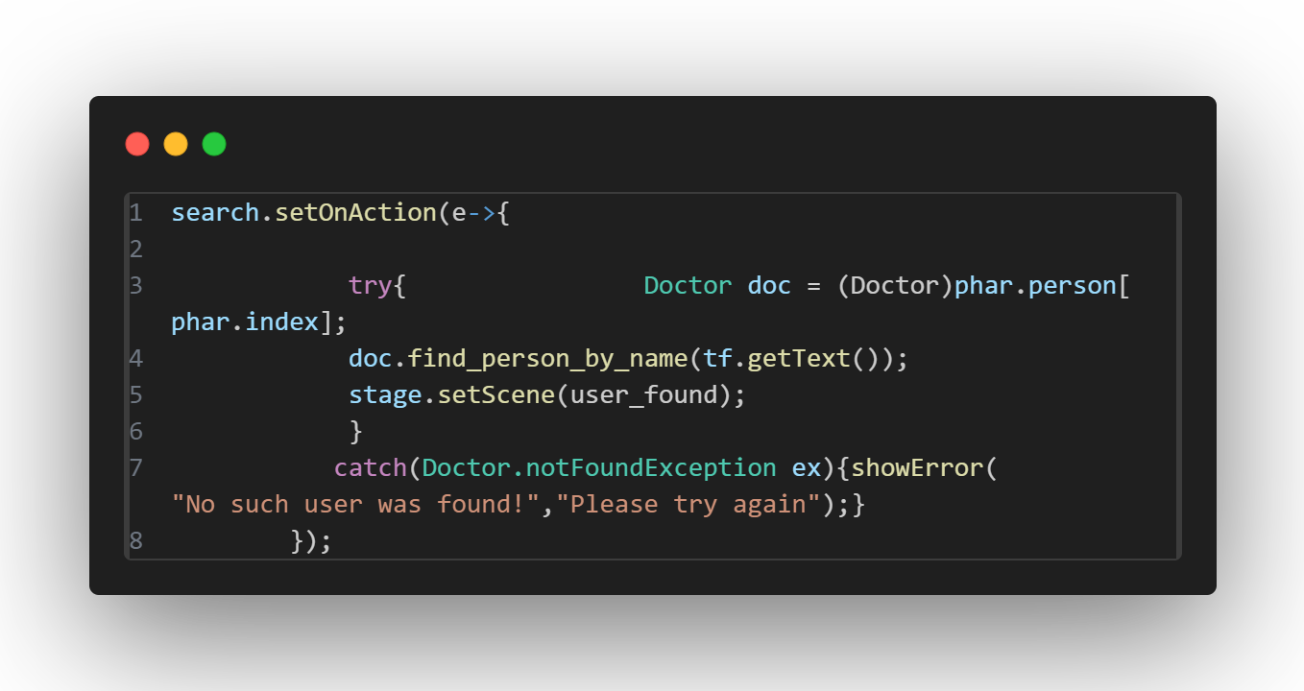
Controllers
Communication between GUI and back end methods

Slide 31
GitHub Repository
GitHub

Slide 32
Thank You☺

